Slide 1

CSE310: Programming in Java
Fundamentals of Programming in Java

Slide 2
Naming Conventions
All the letters of an identifier in Java should be in lower case Except:
Class Names: First letter of each word in the identifier should be capitalized.
Method Names: First letter of each word in the identifier should be capitalized except the first word.

Slide 3
Identifiers
A name in a program is called an identifier.
Identifiers can be used to denote classes, methods, variables, and labels.
An identifier may be any descriptive sequence of uppercase and lowercase letters, numbers, or the underscore and dollar-sign characters.
Example: number, Number, sum_$, bingo, $$_100
Note: Identifiers must not begin with a number.

Slide 4
Keywords
Keywords are reserved identifiers that are predefined in the language.
Cannot be used as names for a variable, class, or method.
All the keywords are in lowercase.
There are 50 keywords currently defined in the Java language.
The keywords const and goto are reserved but not used.
true, false, and null are also reserved.

Slide 5
Java Keywords
abstract | char | else | goto | long | return | throw
assert | class | enum | if | native | short | throws
boolean | const | extends | implements | new | static | this
break | continue | final | import | package | strictfp | transient
byte | default | finally | instanceof | private | super | void
case | do | float | int | protected | switch | try
catch | double | for | interface | public | synchronized | while and volatile

Slide 6
Writing Your First Java Program
class MyJavaProgram
{
public static void main(String args[])
    {
    System.out.println(“Have fun in Java…”);
    }
}

Slide 7
Blank slide

Slide 8
Understanding first java program
Let's see what is the meaning of class, public, static, void, main, String[], System.out.println().
class keyword is used to declare a class in java.
public keyword is an access modifier which represents visibility, it means it is visible to all.
static is a keyword, if we declare any method as static, it is known as static method. The core advantage of static method is that there is no need to create object to invoke the static method. The main method is executed by the JVM, so it doesn't require to create object to invoke the main method. So it saves memory.
void is the return type of the method, it means it doesn't return any value.
main represents startup of the program.
String[] args is used for command line argument.
System.out.println() is used print statement.

Slide 9
System.out.println is a Java statement that prints the argument passed, into the System.out which is generally stdout.
System is a Class
out is a Static Member Field
println() is a method
System is a class in the java.lang package . The out is a static member of the System class, and is an instance of java.io.PrintStream . The println is a method of java.io.PrintStream. This method is overloaded to print message to output destination, which is typically a console or file.
class System {
public static final PrintStream out;
//...
}
the System class belongs to java.lang package
class PrintStream{
public void println();
//...
}
the Prinstream class belongs to java.io package

Slide 10
Compiling and Executing Java Program
Step-1: Save your file with .java extension.
Example: Program1.java
NOTE: If the class is public then the file name MUST BE same as the name of the class.
Step-2: Compile your .Java file using javac compiler from the location where the file is saved.
javac Program1.java

Slide 11
Compiling and Executing Java Program
Step-3: Execute your java class which contains the following method: public static void main(String args[]) {}
java MyJavaProgram

Slide 12
Objects
Object is an instance of a class. Class is a template or blueprint from which objects are created. So object is the instance(result) of a class.
Object is a real world entity.
Object is a run time entity.
Object is an entity which has state and behavior.
Object is an instance of a class.

Slide 13
class
class in Java
A class is a group of objects which have common properties. It is a template or blueprint from which objects are created. It is a logical entity. It can't be physical.
A class in Java can contain:
fields
methods
constructors
blocks
nested class and interface

Slide 14
new
new keyword in Java
The new keyword is used to allocate memory at run time. All objects get memory in Heap memory area.

Slide 15
Object and Class Example: main within class
class Student{
int id;//field or data member or instance variable
String name;
public static void main(String args[]){
Student s1=new Student();//creating reference to object of Student
System.out.println(s1.id);//accessing member through reference variable
System.out.println(s1.name);
}
}
Notes:
Save with Student.java Output: 0 and null

Slide 16
Object and Class Example: main outside class
class Student{
int id;
String name;
}
class TestStudent1{
public static void main(String args[]){
Student s1=new Student();
System.out.println(s1.id);
System.out.println(s1.name);
}
}
Notes:
TestStudent1.java Output: 0 and null

Slide 17
Initialize object
3 Ways to initialize object
There are 3 ways to initialize object in java.
By reference variable
By method
By constructor

Slide 18
1) Initialization through reference
Initializing object simply means storing data into object. Let's see a simple example where we are going to initialize object through reference variable.

Slide 19
class Student{
int id;
String name;
}
class TestStudent2{
public static void main(String args[]){
Student s1=new Student();
s1.id=101;
s1.name="Sonoo";
System.out.println(s1.id+" "+s1.name);//printing members with a white space
}
}
Notes:
TestStudent2.java output:101 and Sonoo

Slide 20
Initialization through method
In this example, we are creating the two objects of Student class and initializing the value to these objects by invoking the insertRecord method. Here, we are displaying the state (data) of the objects by invoking the displayInformation() method.

Slide 21
class Student{
int rollno;
String name;
void insertRecord(int r, String n){
rollno=r;
name=n;
}
void displayInformation(){System.out.println(rollno+" "+name);}
}
class TestStudent4{
public static void main(String args[]){
Student s1=new Student();
Student s2=new Student();
s1.insertRecord(111,"Karan");
s2.insertRecord(222,"Aryan");
s1.displayInformation();
s2.displayInformation();
} }
Notes:
111 Karan 222 Aryan

Slide 22
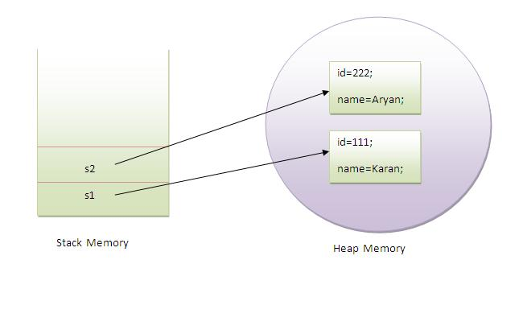

Slide 23
Initialization through constructor
In this example, we are creating the two objects of Student class and initializing the value to these objects by invoking the insertRecord method. Here, we are displaying the state (data) of the objects by invoking the displayInformation() method.

Slide 24
class Box {
double width; double height; double depth;
// This is the constructor for
Box. Box()
{ System.out.println("Constructing Box");
width = 10; height = 10; depth = 10; }
// compute and return volume
double volume() { return width * height * depth; }
}
class BoxDemo6 { public static void main(String args[]) {
// declare, allocate, and initialize Box objects
Box mybox1 = new Box(); Box mybox2 = new Box();
double vol;
// get volume of first box
vol = mybox1.volume(); System.out.println("Volume is " + vol);
// get volume of second box
vol = mybox2.volume(); System.out.println("Volume is " + vol);
}
}
Notes:
TestEmployee.java
output: 101 ajeet 45000.0 102 irfan 25000.0 103 nakul 55000.0

Slide 26


